Slide 1

Real Time Facial Recognition
ORIENTAL COLLEGE OF TECHNOLOGY, BHOPAL
DEPARTMENT OF COMPUTER SCIENCE AND ENGINEERING
Project Developed by: GroupNO. 32
Akash Haripriya (0126CS191016)
Abhinav Saini (0126CS191008)
Ashish Karamchandani (0126CS191026)
Academic Year: 2021-2022 Session: JunDec 2021

Slide 2

Presentation Outline
Introduction
Objectives
Application Feature Overview
Technical Strength
Proposed Idea
Project Scope
Future of Facial Recognition
Facial recognition Lifecycle / Flow Chart
Project Screenshots
Team Collaboration
Technical Requirements
Bibliography

Slide 3
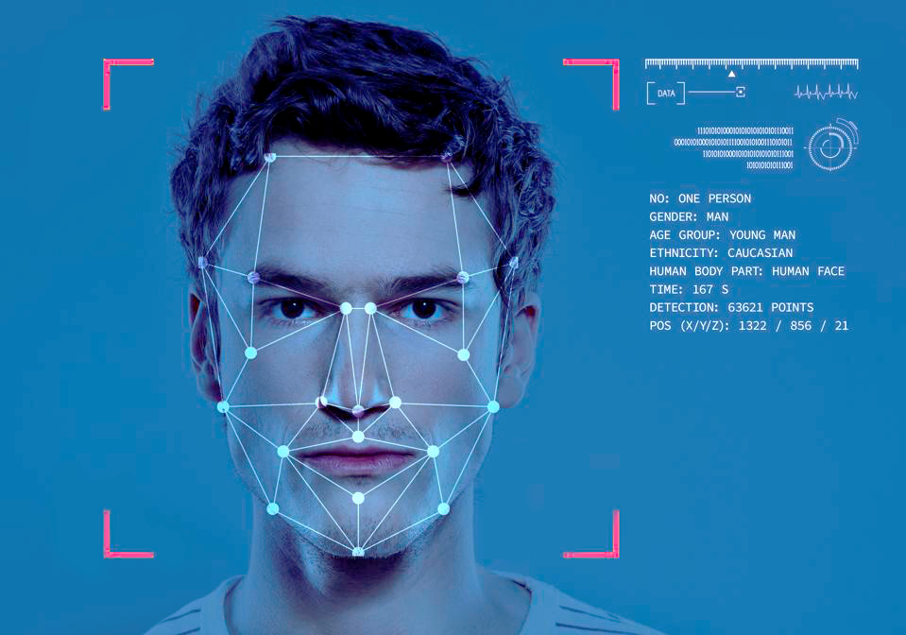
Introduction
Human beings displays their emotions using facial expressions. For human it is very easy to recognize those emotions but for computer it is very challenging. Facial expressions vary from person to person
The facial expression recognition is an active research area. In this project, we worked on recognition of seven basic human emotions. These emotions are angry, disgust, fear, happy, sad, surprise and neutral.

Slide 4

Objective of the Project
In this we are presenting the Attendance System Project Using Face Recognition. Basically to implement Student attendance system based on the face recognition of webcam’s image in the classroom.
Facial recognition is a way of identifying or confirming an individual’s identity using their face. Facial recognition systems can be used to identify people in photos, videos, or in real-time.

Slide 5
Applications
Helps find missing people and identify perpetrators: Law enforcement agencies use facial recognition to identify criminals with no other means of identification and find missing people by comparing faces on live camera feeds with those on a watch list.
Strengthens security measures in banks and airports: t’s been a regular part of airport security screening for years. Similar to identifying criminals that come into shops, the software has helped identify criminals and potential threats to airlines and passengers.
Makes shopping more efficient: Instead of making cash or credit purchases at stores, facial recognition technology can recognize your face and charge the goods to your account.
Reduces the number of touchpoints: It limits touchpoints when unlocking doors and smartphones, getting cash from the ATM or performing any other task that generally requires a PIN, password or key.

Slide 6



Technical Strength
Technical Strength of our team :-
Python
Graphic Designing
Web Development

Slide 7
Proposed Idea
Facial Emotion Recognition. Facial Emotion Recognition (FER) is the technology that analyses facial expressions from both static images and videos in order to reveal information on one's emotional state.It belongs to the family of technologies often referred to as ‘affective computing’, a multidisciplinary field of research on computer’s capabilities to recognise and interpret human emotions and affective states and it often builds on Artificial Intelligence technologies

Slide 8
Project Scope
Attendance system using face recognition is a procedure of recognizing students by using face biostatistics based on the high-definition monitoring and other computer technologies. The development of this system is aimed to accomplish digitization of the traditional system of taking attendance by calling names and maintaining pen-paper records.

Slide 9
Future of Facial Recognition
There are currently no regulations in the United States expressly covering biometric data of a person. Facial recognition devices are already being tested or implemented for airport protection, and it is reported that their faceprint has now been produced by more than half the United States populace. Information may be collected and processed by a facial recognition program, and a person does not even recognize it. Then, a hacker might reach the details, and the knowledge of a person would propagate without even realizing it. Government entities or marketers may use this data to monitor individuals too. Worse still, a false positive may include a person for a crime they are not.
Hundreds of companies have embraced face recognition. Integrating and installing is reasonably straightforward, but it has also provided users a feeling of utilizing a system that is more sophisticated and safer than passwords or PINs, thereby increasing user experience. Nonetheless, plenty is often unclear on the road to implementing what many deem the ideal biometric approach, causing several relatively severe blunders along the way.

Slide 10
Facial recognition Lifecycle / Flow Chart
Input Image
PRE PROCESSING
FACE DETECTION AND FACIAL EXPRESSION EXTRACTION
EMOTION CLASSIFICATION AND OUTPUT

Slide 11
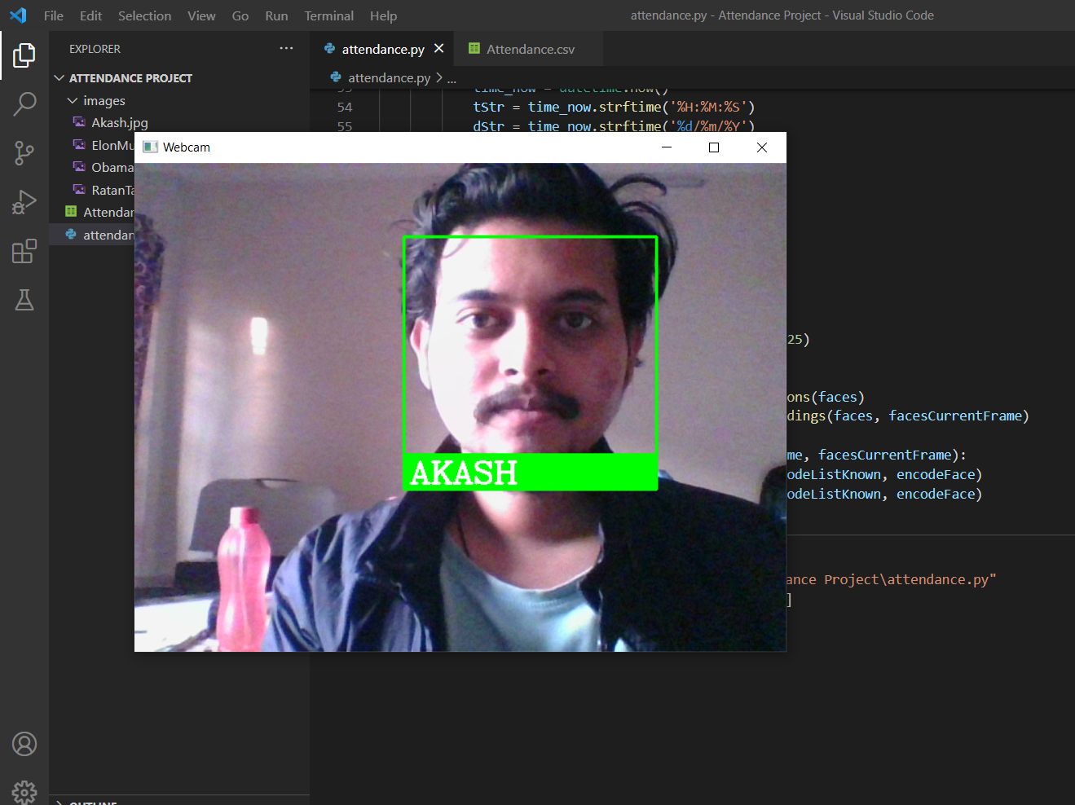
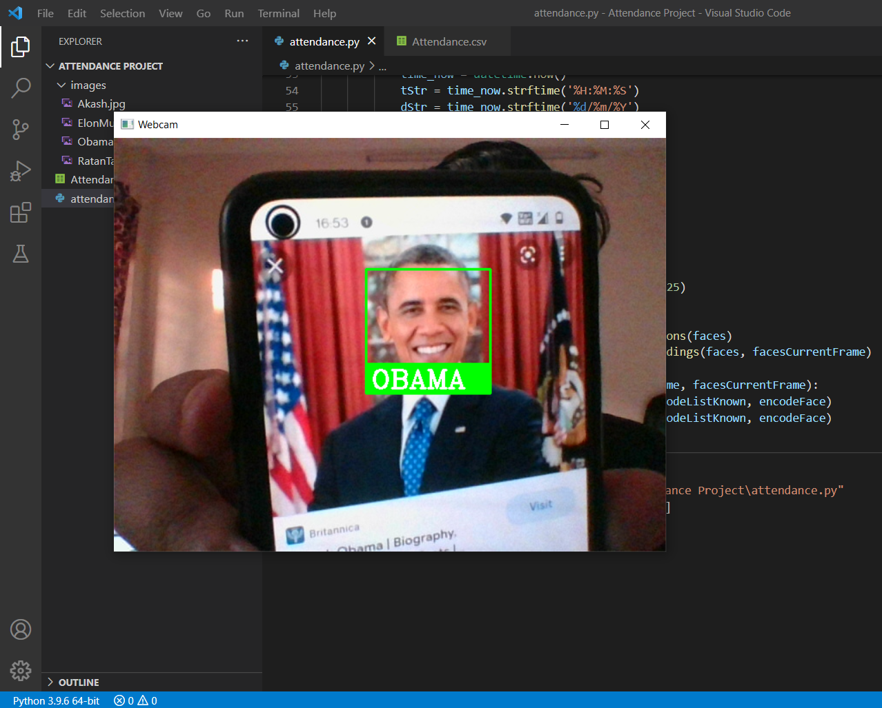
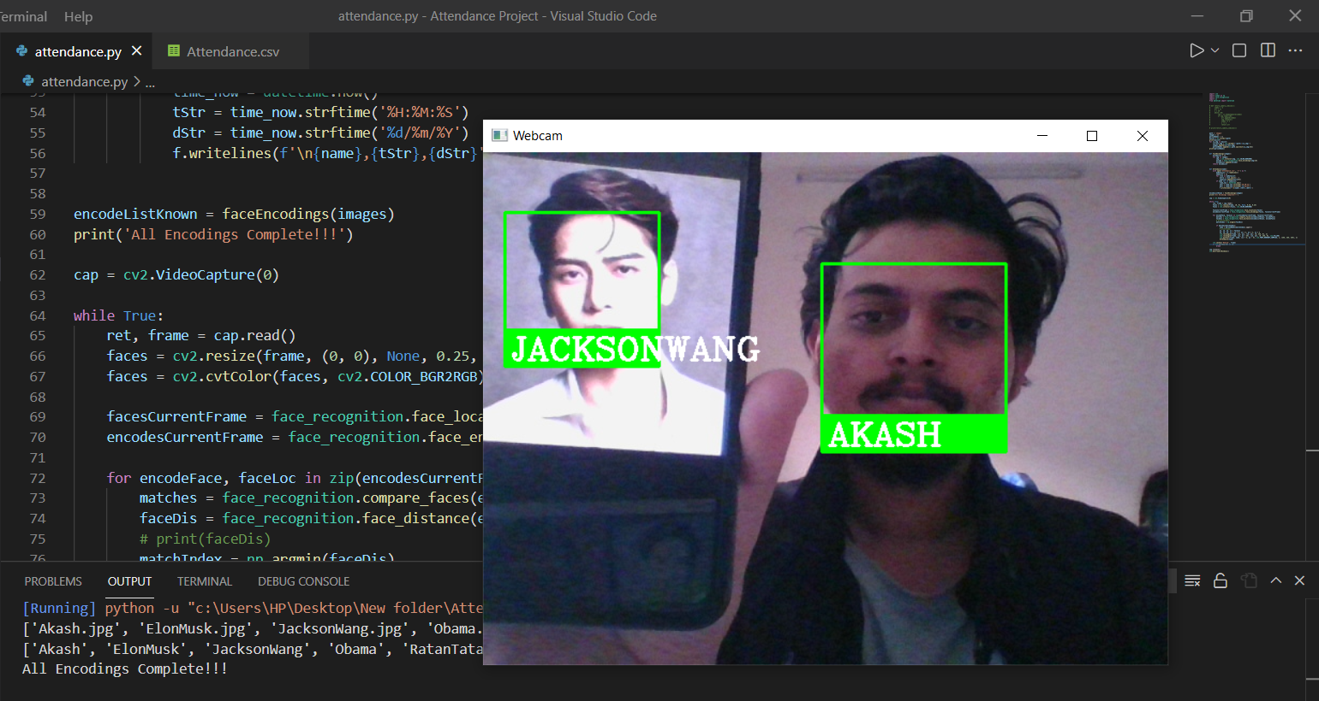
Project Screenshots

Slide 12

Team Collaboration
Akash Haripriya will prepare Data Set and Coding stuff.
Abhinav Saini will prepare our Project PPT.
Ashish Karamchandani will prepare our Project Report.

Slide 13

Technical Requirements
You need to have installed following software's and libraries in your machine before running this project.
Python 3
Anaconda: It will install python notebook and most of the libraries which are needed like sklearn, pandas, seaborn, matplotlib, NumPy, PIL.
OpenCV
Cmake
Dlib
Facial Recognition

Slide 14
Bibliography:
Github: https://github.com/ageitgey/face_recognition
YouTube: https://www.youtube.com/watch?v=sz25xxF_AVE
greeks for greeks: https://www.geeksforgeeks.org/face-recognition-using-artificial-intelligence/

Slide 15


